Slide 1

PHOTO SHARP
PHOTO SHARP

Slide 2

Moha Arzhang
Ali Vakili
Davood Haris

Slide 3
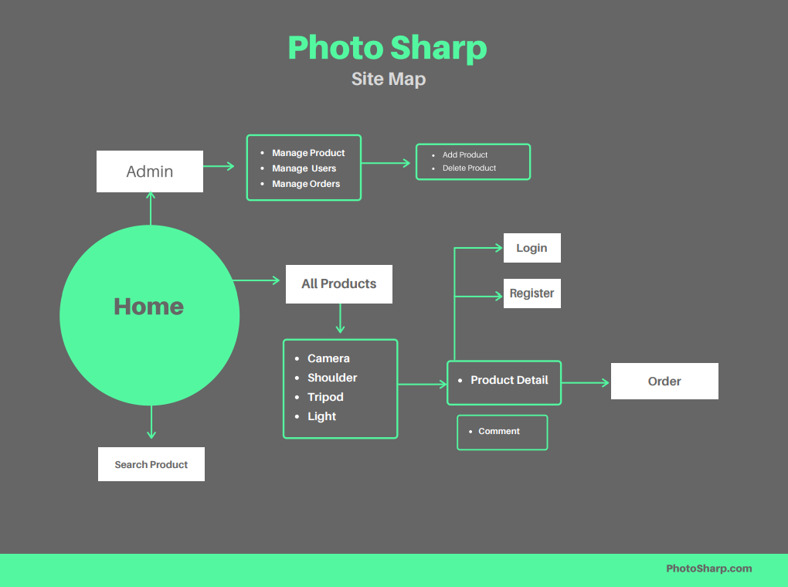


Slide 4
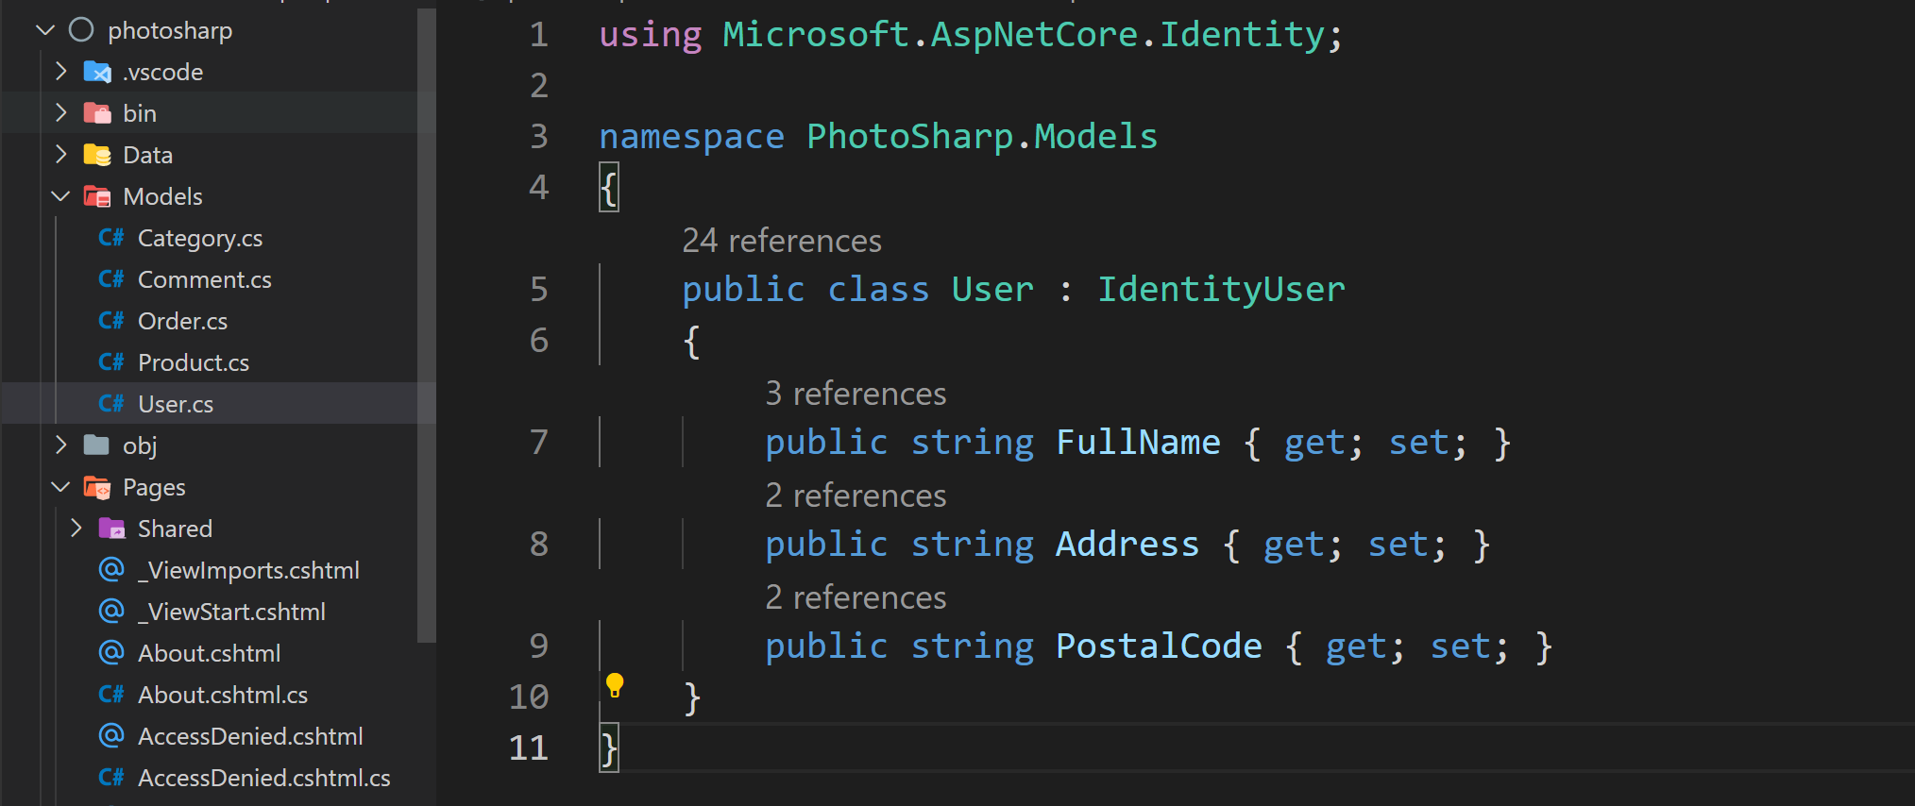


Slide 5

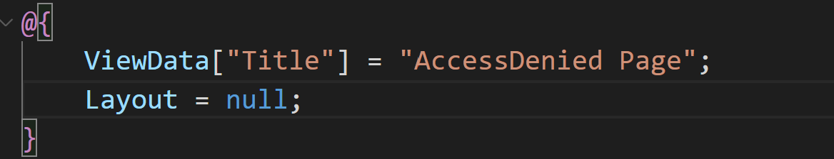

Slide 6
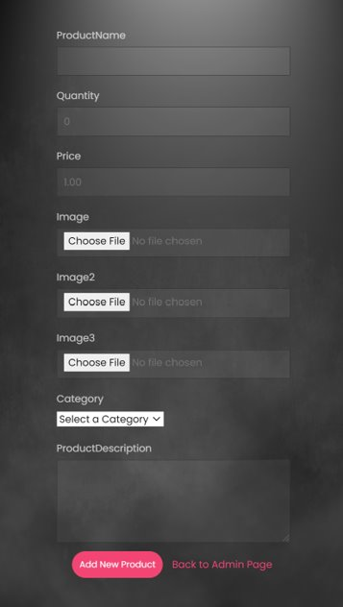
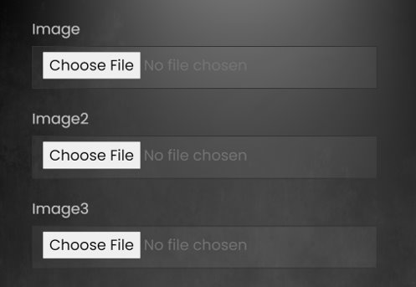
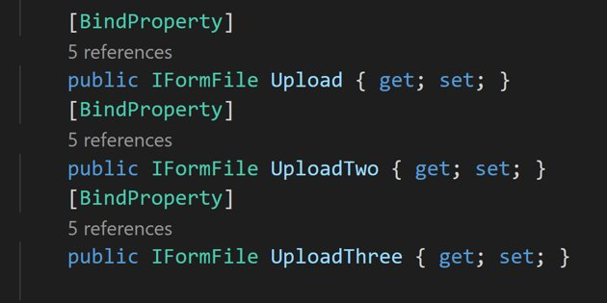

Slide 7
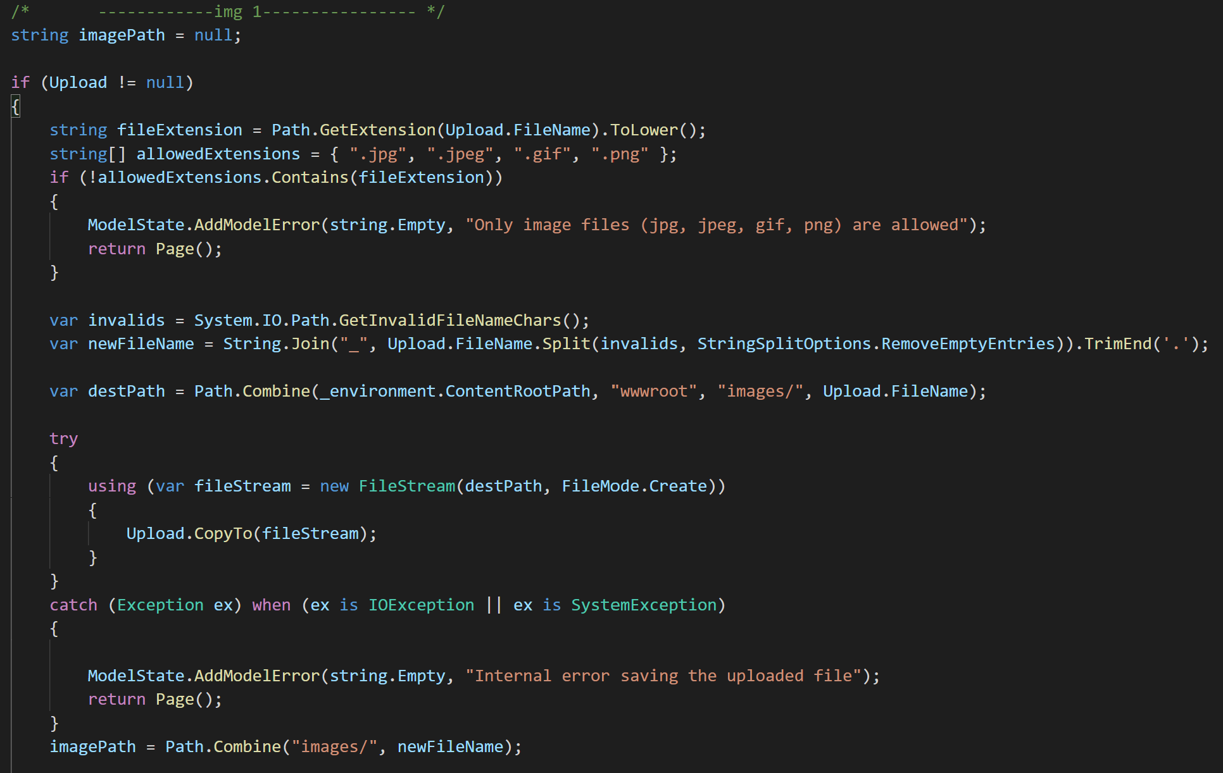
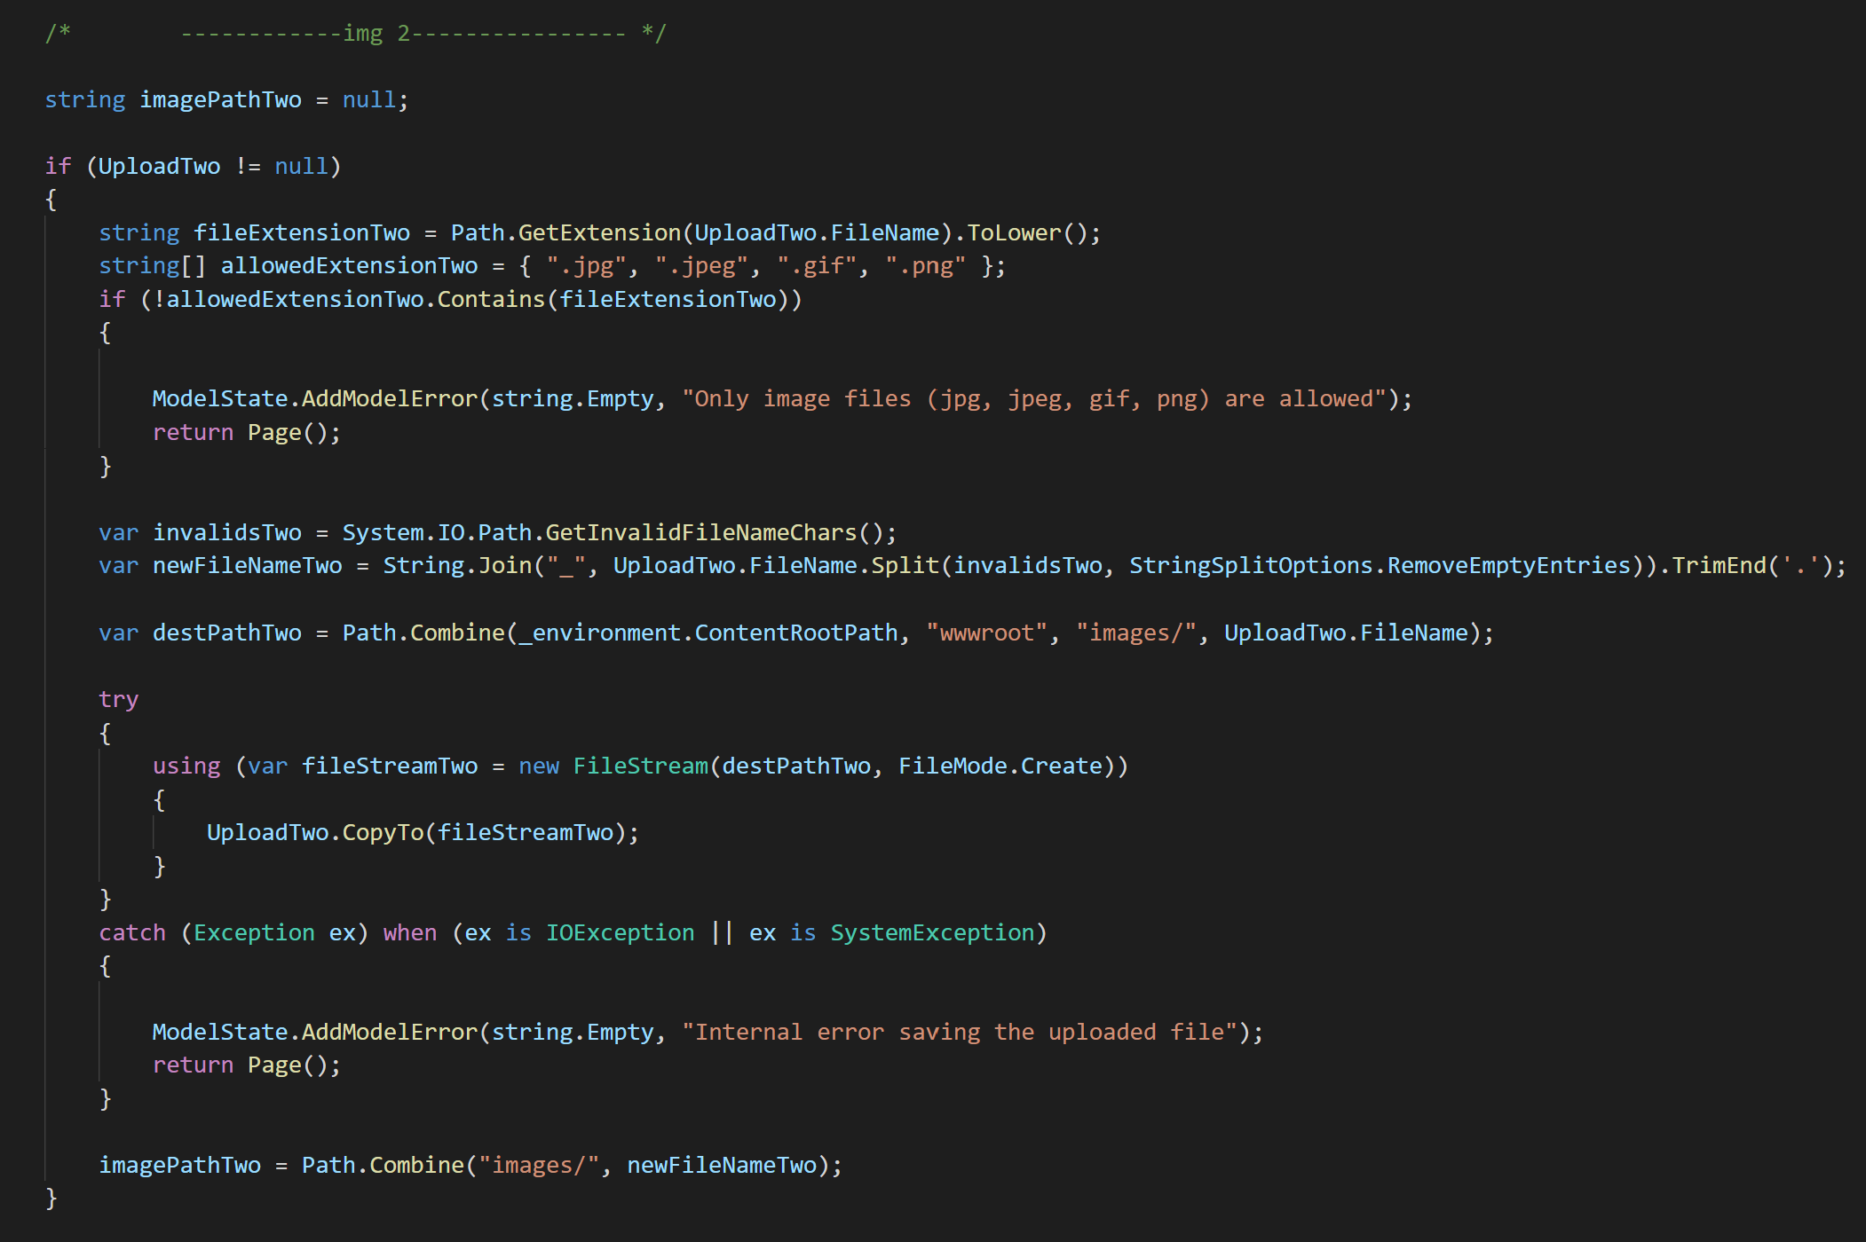
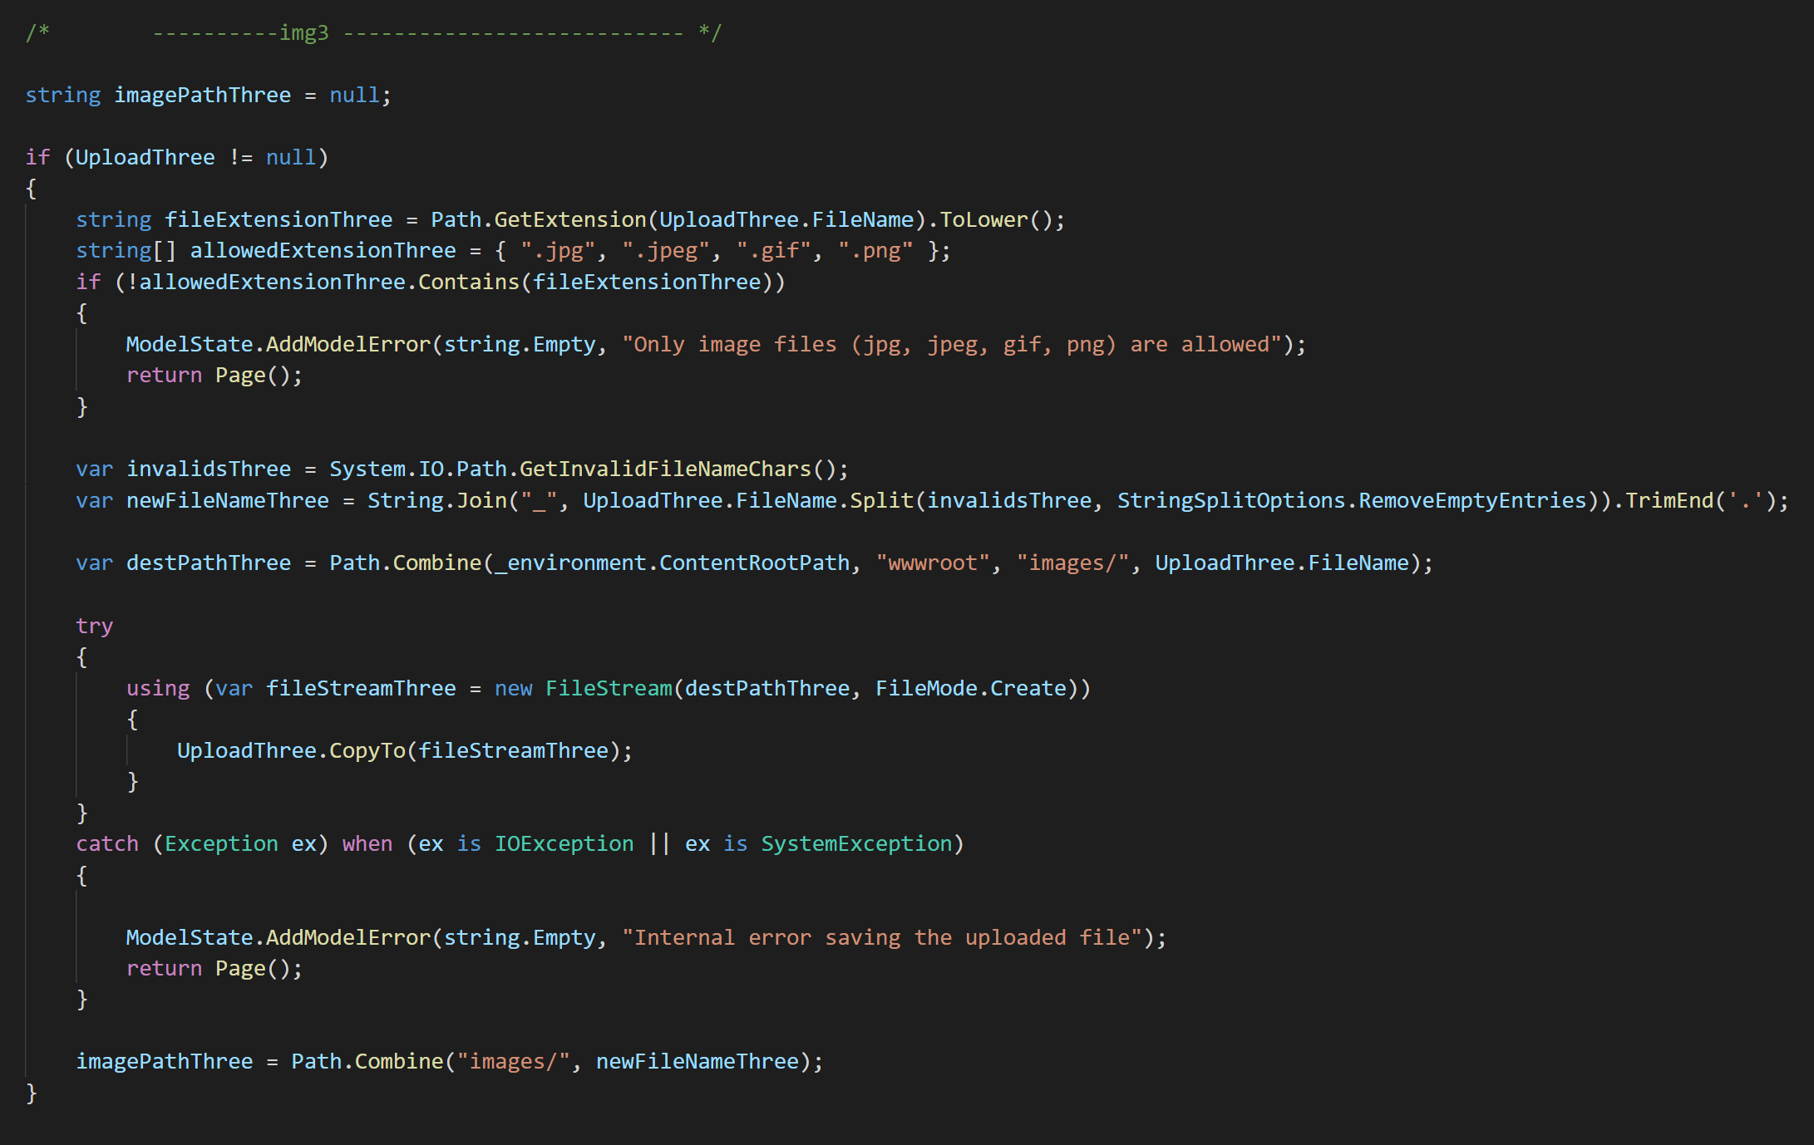
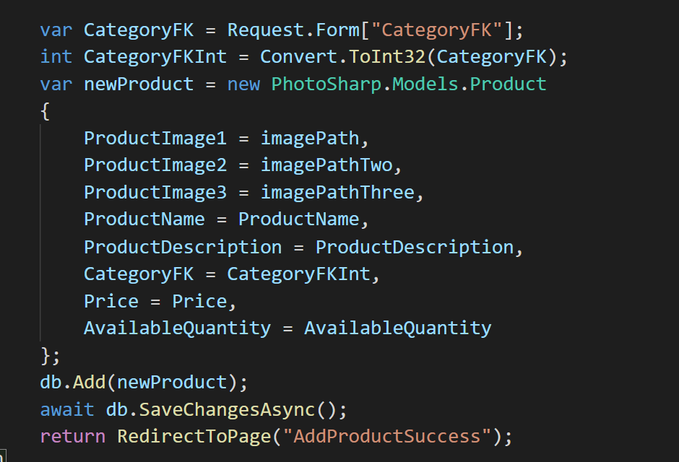
Upload img-1
Upload img-2
Upload img-3

Slide 8
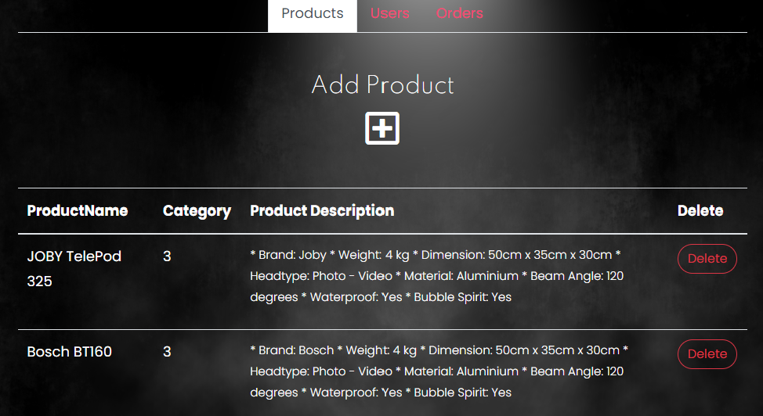

Slide 9
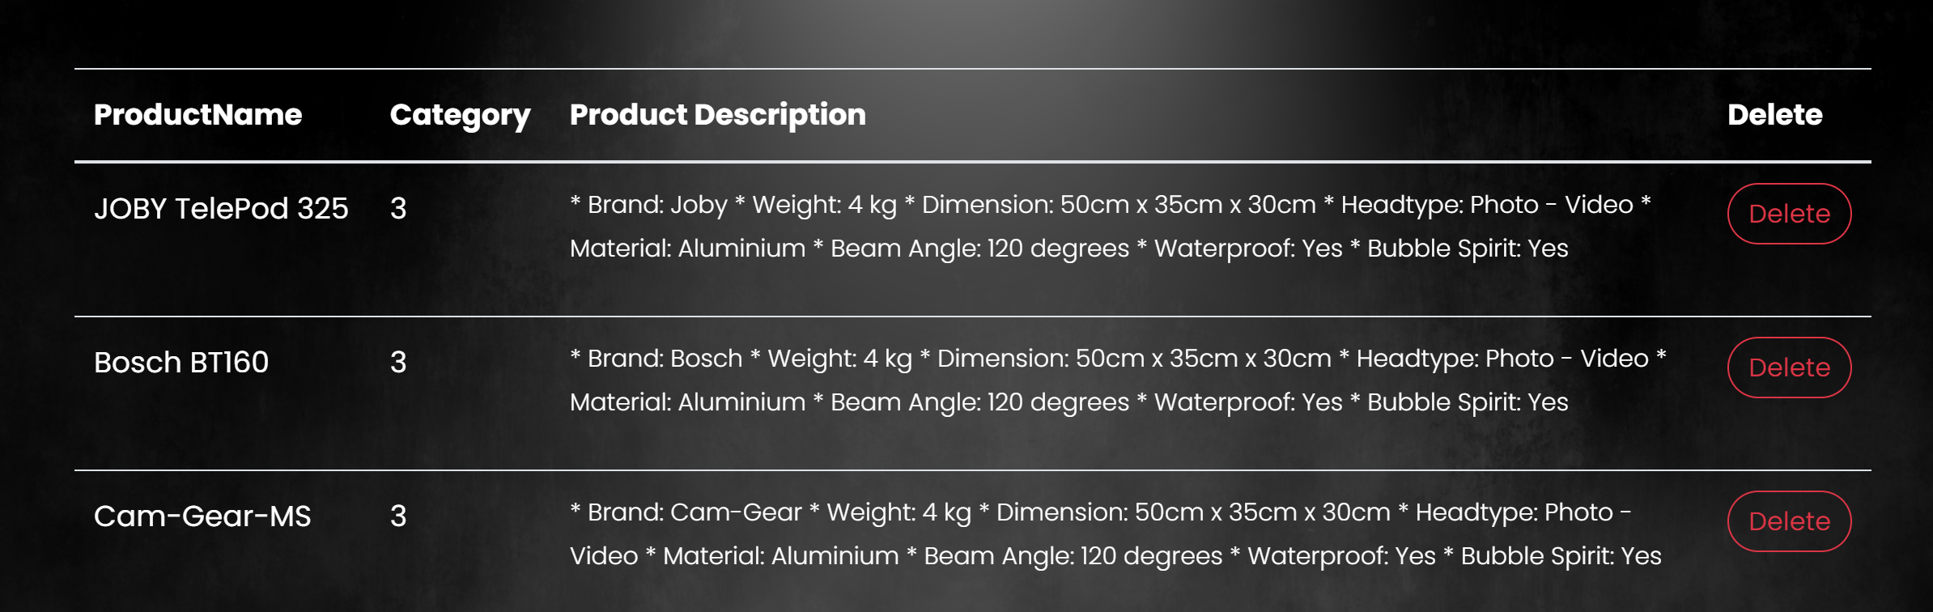



<Button> </Button>
<a> </a>

Slide 10

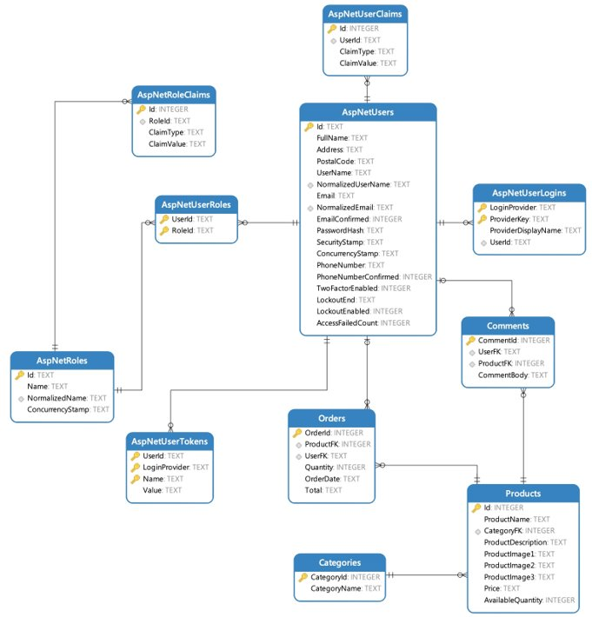
PhotoSharp​
DATABASE

Slide 11

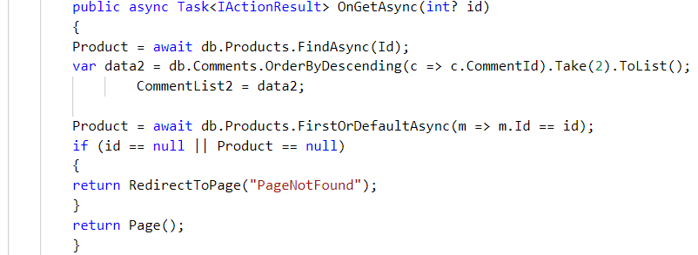
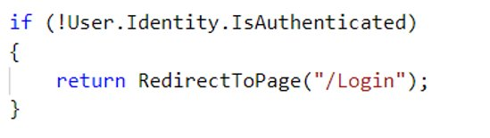
ORDER PAGE

Slide 12

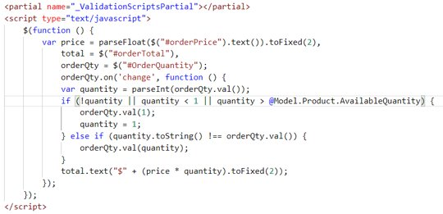
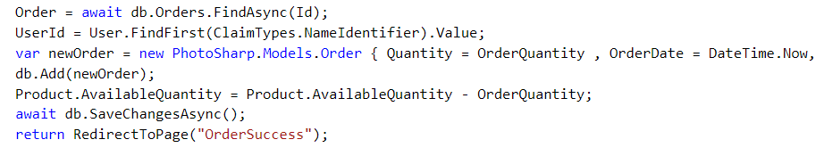
ORDER PAGE

Slide 13

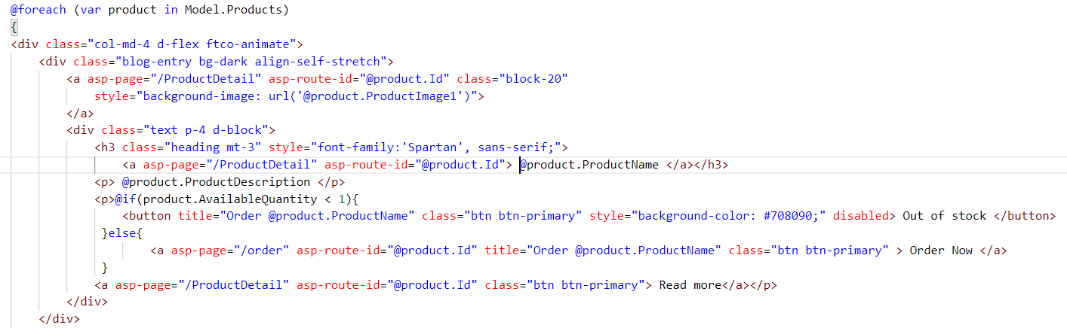
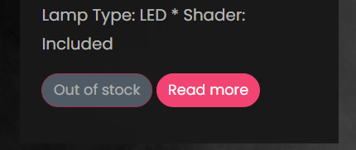
Product Page
Products = await db.Products.OrderByDescending(c => c.Id).ToListAsync();
<head runat="server">
<meta http-equiv="Refresh" content="5;url=Index" />
</head>

Slide 14

New Project
New Challenges

Slide 15

@page "{Id:int}"
public IActionResult OnGet(int? Id)

Slide 16

Camera
All Products
ID = 1
Shoulder
ID
ID = 2
IF condition
Tripod
ID = 3
Product Details
ID = 4
Light

Slide 17

Redirect to new page and passing the ID
return RedirectToPage("/ProductDetailCamera", new { Id = Product.Id });

Slide 18

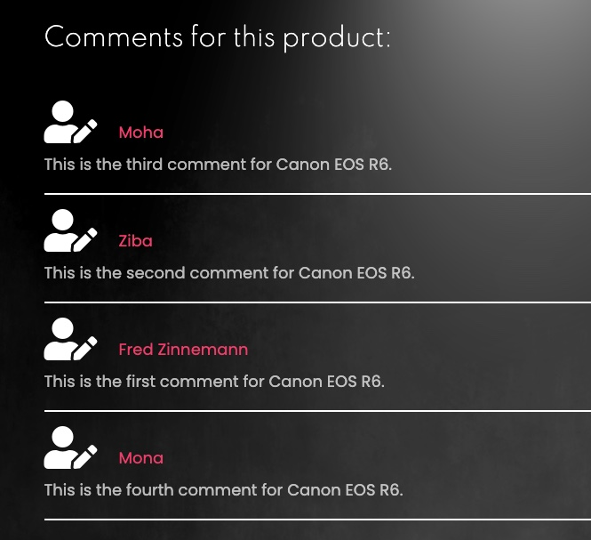


Slide 19
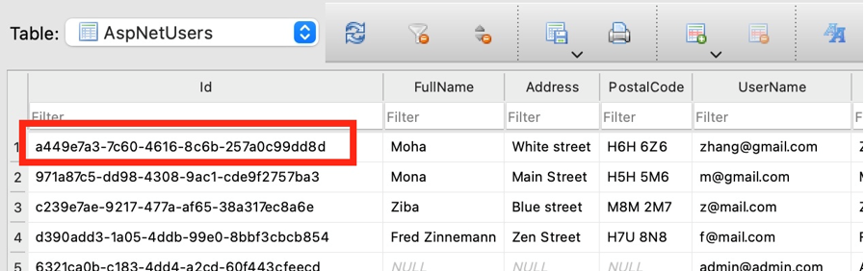

using System.Security.Claims;
public User User { get; set; }
var userId = User.FindFirstValue(ClaimTypes.NameIdentifier);

Slide 20



Slide 21

public List<Comment> CommentList { get; set; } = new List<Comment>();
var data = db.Comments.OrderByDescending(c => c.CommentId)
.Take(2).ToList();
CommentList = data;

Slide 22

Thank You

